Slide 1
Orchestrating Intelligent Systems
Geoff Hulten

Slide 2
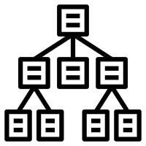
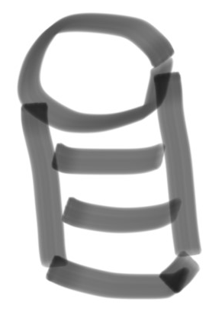



Refresher: an Intelligent System Implementation
Intelligence Management
Verify new intelligence
Control rollouts:
  Keep in sync
  Clients/services
Support online evaluation
Intelligence Creation Environment
Intelligence Runtime
Intelligence Orchestration
Achieve Objectives Over Time
Balance: Experience, Intelligence, & Objective
Mitigate Mistakes Effectively
Scale Efficiently
Degrade Slowly
Program State -> Context
Execute Feature Code
Execute Model
Interpret Model Output
Control User Experience
Update:
  Models
  Feature Code
Telemetry -> Context
Feature code in sync
Computation & Data
All the training stuff…
Telemetry
Verifying outcomes
Training data
Selecting what to observe
  Sampling
  Summarizing

Slide 3
Why Orchestration is Needed
Objective Changes
  Understand Problem Better
  Solved Previous Objective
  Decide Problem Too Hard
Users Change
  New Users Come
  Usage Pattern Changes
  Users Adapt to Experience
  Users Leave
Intelligence Changes
  More Data -> Better Models
  More Accurate Modeling
  Less Accurate Modeling
Costs Change
  Telemetry Costs
  Mistake Costs
Abuse

Slide 4
Orchestration Team Needs
Domain experts in the business of the system
Understand users experience
Understand the implementation
Can ask questions of data
Applied Machine Learning
Desire for Operational Excellence

Slide 5
Mistakes
Sources of Mistakes
System Outage
  Something unrelated to the models
Model Outage
  Corruption or things get out of sync
Model Mistakes
  Standard errors FPs/FNs
Model Degradation
  Errors that develop slowly as things change
Find the worst thing

Slide 6
Tools for Orchestration
Monitoring Success Criteria
Inspecting Interactions
Balancing the Experience
Overriding the Intelligence
Creating new Intelligence

Slide 7
Monitoring Success Criteria
What
How
Business Objectives
Leading Indicators
User Outcomes
Model Properties
Ad hoc
  Write scripts to query logs
Tool-Based
  Accessible to non-data scientists
Automated
  Dashboard updated regularly
Alert-Based
  Flag on major change – rapid or sustained
Population Tracking
  Slice and dice by user segments

Slide 8
Inspecting Interactions
What
How
Find specific events
Observe the:
  Context -> features
  ‘Live’ model outputs
  Resulting experience
  Outcome
Ad hoc
  Query & join across multiple logs
  Interpret numeric data as experience
Tool
  Non-data scientists query for interactions & see all relevant data
Browser
  Find interactions and visualize experience / outcomes
Live Interaction Inspection
  Inject queries to users in context

Slide 9
Balancing Experience
What
How
Connect intelligence to experience
Frequency
Forcefulness
Actions Taken
  Value
  Mistakes
Ad hoc
  Implement and deploy code
Parameter Updates
  Thresholds
  Frequencies
  Colors
  Text
  Etc.
Experience Alternatives
  Swap between experiences dynamically
Dynamic Experience Updates
  Experience in data (similar to model)

Slide 10
Overriding Intelligence
What
How
Mitigate Critical Mistakes
Implement Guardrails
Lock in Good Behavior
Ad hoc
  Hack the learning process/models
Intelligence Feed
  High priority intelligence in code
Tool Based
  Identify context to override
  Stats on it
  Tracking over time
  Managing lifecycle
Support Tier

Slide 11
Creating New Intelligence
Intelligence Management
  How rapidly updated
  Where lives
  How Combined
Automated Training
  Data to use
  Frequency of training
  Training parameters
  Modeling resources
New Models/Features
  Intelligence creation environment
  Support for updating features
  Adding new models
Telemetry Systems
  Gather new training data
  Sampling rate
  Summarization / Retention

Slide 12
Summary
Machine Learning system live over time
Many reasons they will need to change
People who built the system aren’t always best to run it
Successful Orchestration
  Achieve Objectives over Time
  Balance: Experience, Intelligence, & Objective
  Mitigate Mistakes Effectively
  Scale Efficiently
  Degrade Slowly
Tools for Orchestration
  Monitoring Success Criteria
  Inspecting Interactions
  Balancing the Experience
  Overriding the Intelligence
  Creating new Intelligence

